Slide 1
A universal two-qubit computational register for trapped-ion quantum processors
Nicolas Pulido-Mateo^{1,2}, Hardik Mendpara^{1,2}, Markus Duwe^{1,2}, Giorgio Zarantonello^{1,3}, Amado Bautista-Salvador^{1,2,3}, Ludwig Krinner^{1,2} and Christian Ospelkaus^{1,2,3}
¹Institut für Quantenoptik, Leibniz Universität Hannover, Welfengarten 1, 30167 Hannover
²PTB, Bundesallee 100, 38116 Braunschweig
³QUDORA Technologies GmbH, Wilhelmsgarten 3, 38100 Braunschweig
Notes:
Transition 1
Hello, my name is Nicolas Pulido and the title of my talk is "A universal two-qubit computational register for trapped –ion quantum processors".
I'm a PhD student in Chrisitan Ospelkaus' group and I'm officially from the Institute of Quantum Optics in Hannover but my lab is at PTB Braunschweig.
I'm going to talk about how we built a two-qubit register that can act as the computational core in a quantum processor based in trapped ions

Slide 2

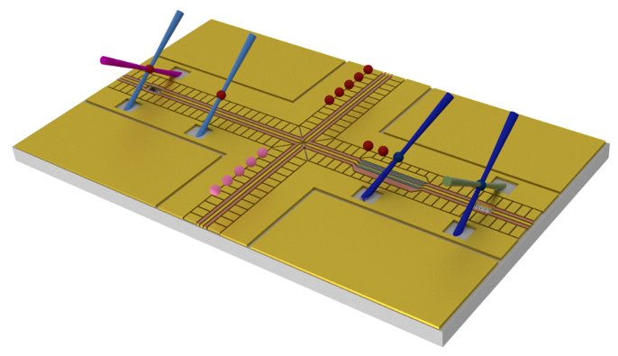
Motivation
https://www.qvls-q1.de
QVLS-Q1
  Trapped-ion based
  QCCD architecture
  Surface-electrode trap
  Multizone:
    Trapping
    Storage
    State preparation and readout
    Computation
Characterization and benchmarking
  Universal set of gates
    Two-qubit entangling gate
    Single-qubit rotations
D. Wineland et al., J. Res. NIST 103 (1998)
D. Kielpinski et al., Nature 417 (2002)

Slide 3
Outline
Experimental setup
Two-qubit entangling gates
Single-qubit rotations
Cycle Benchmarking experiment
Discussion
Notes:
Add part of greater project QCLS Q1

Slide 4
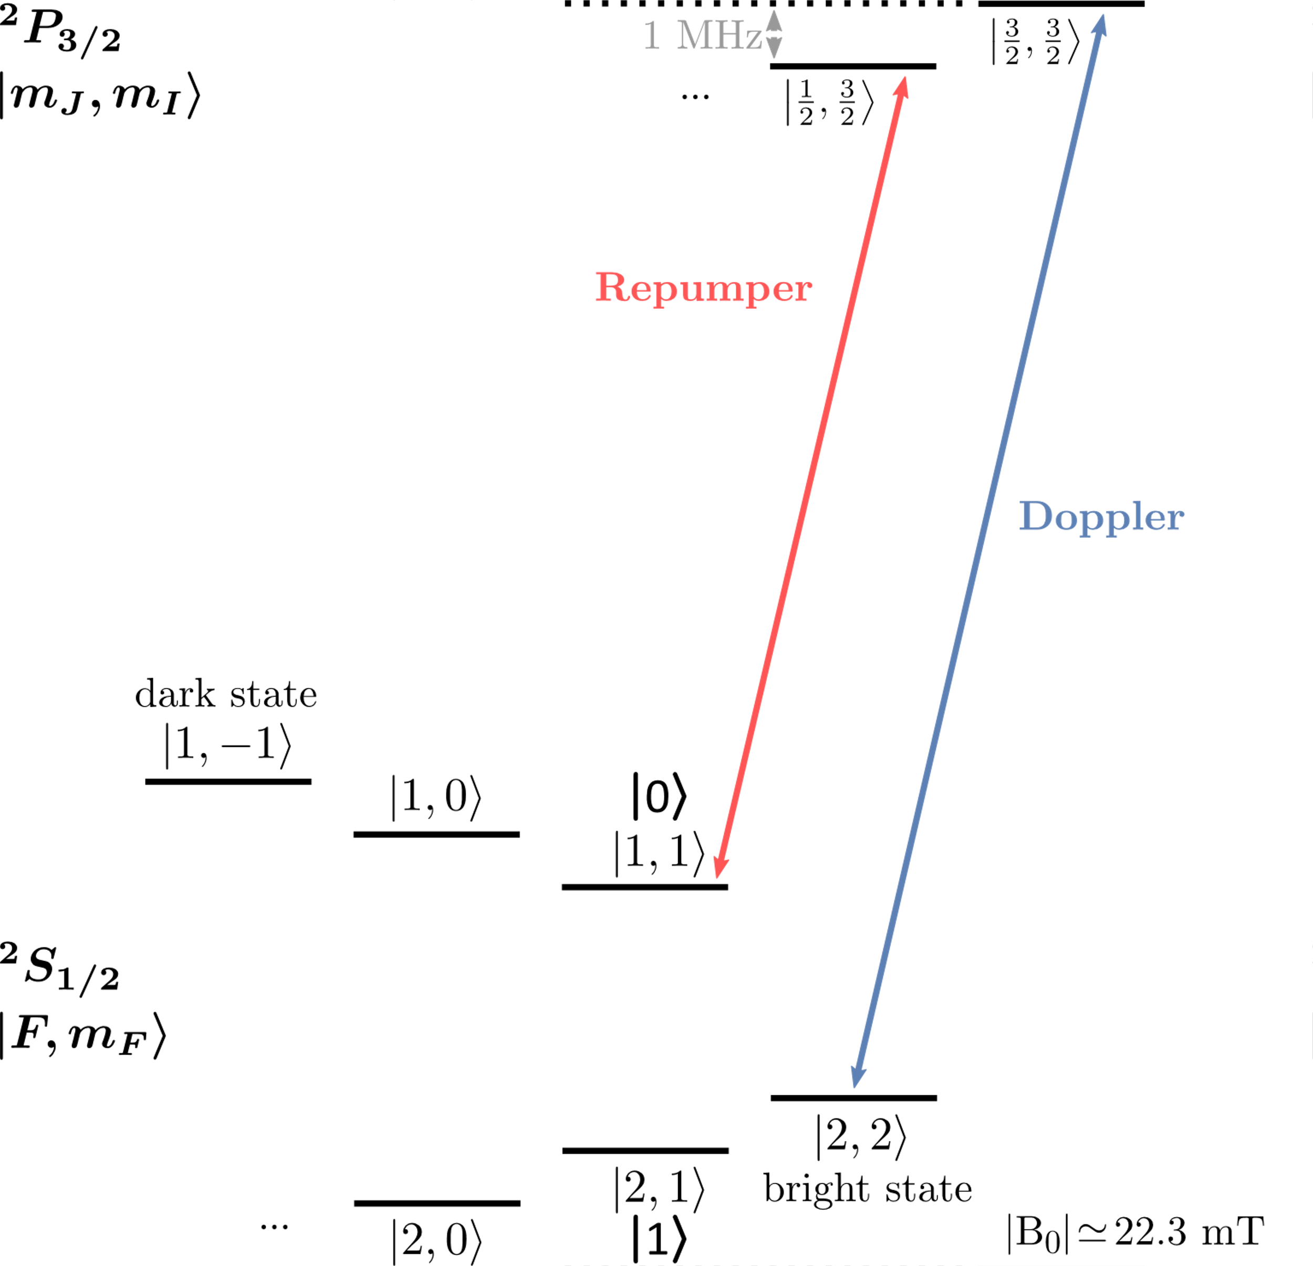
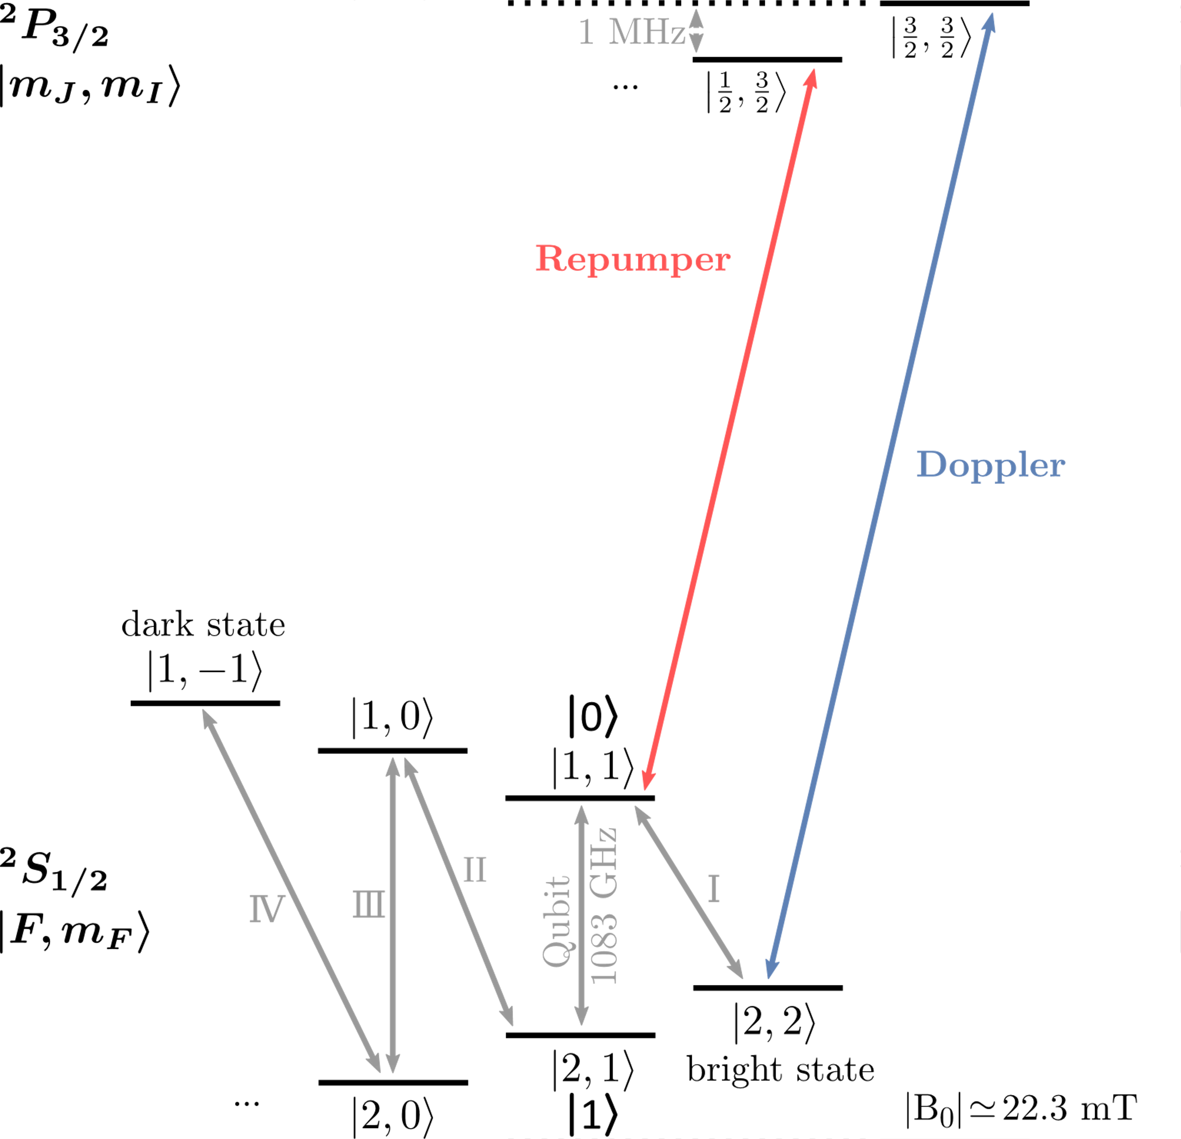
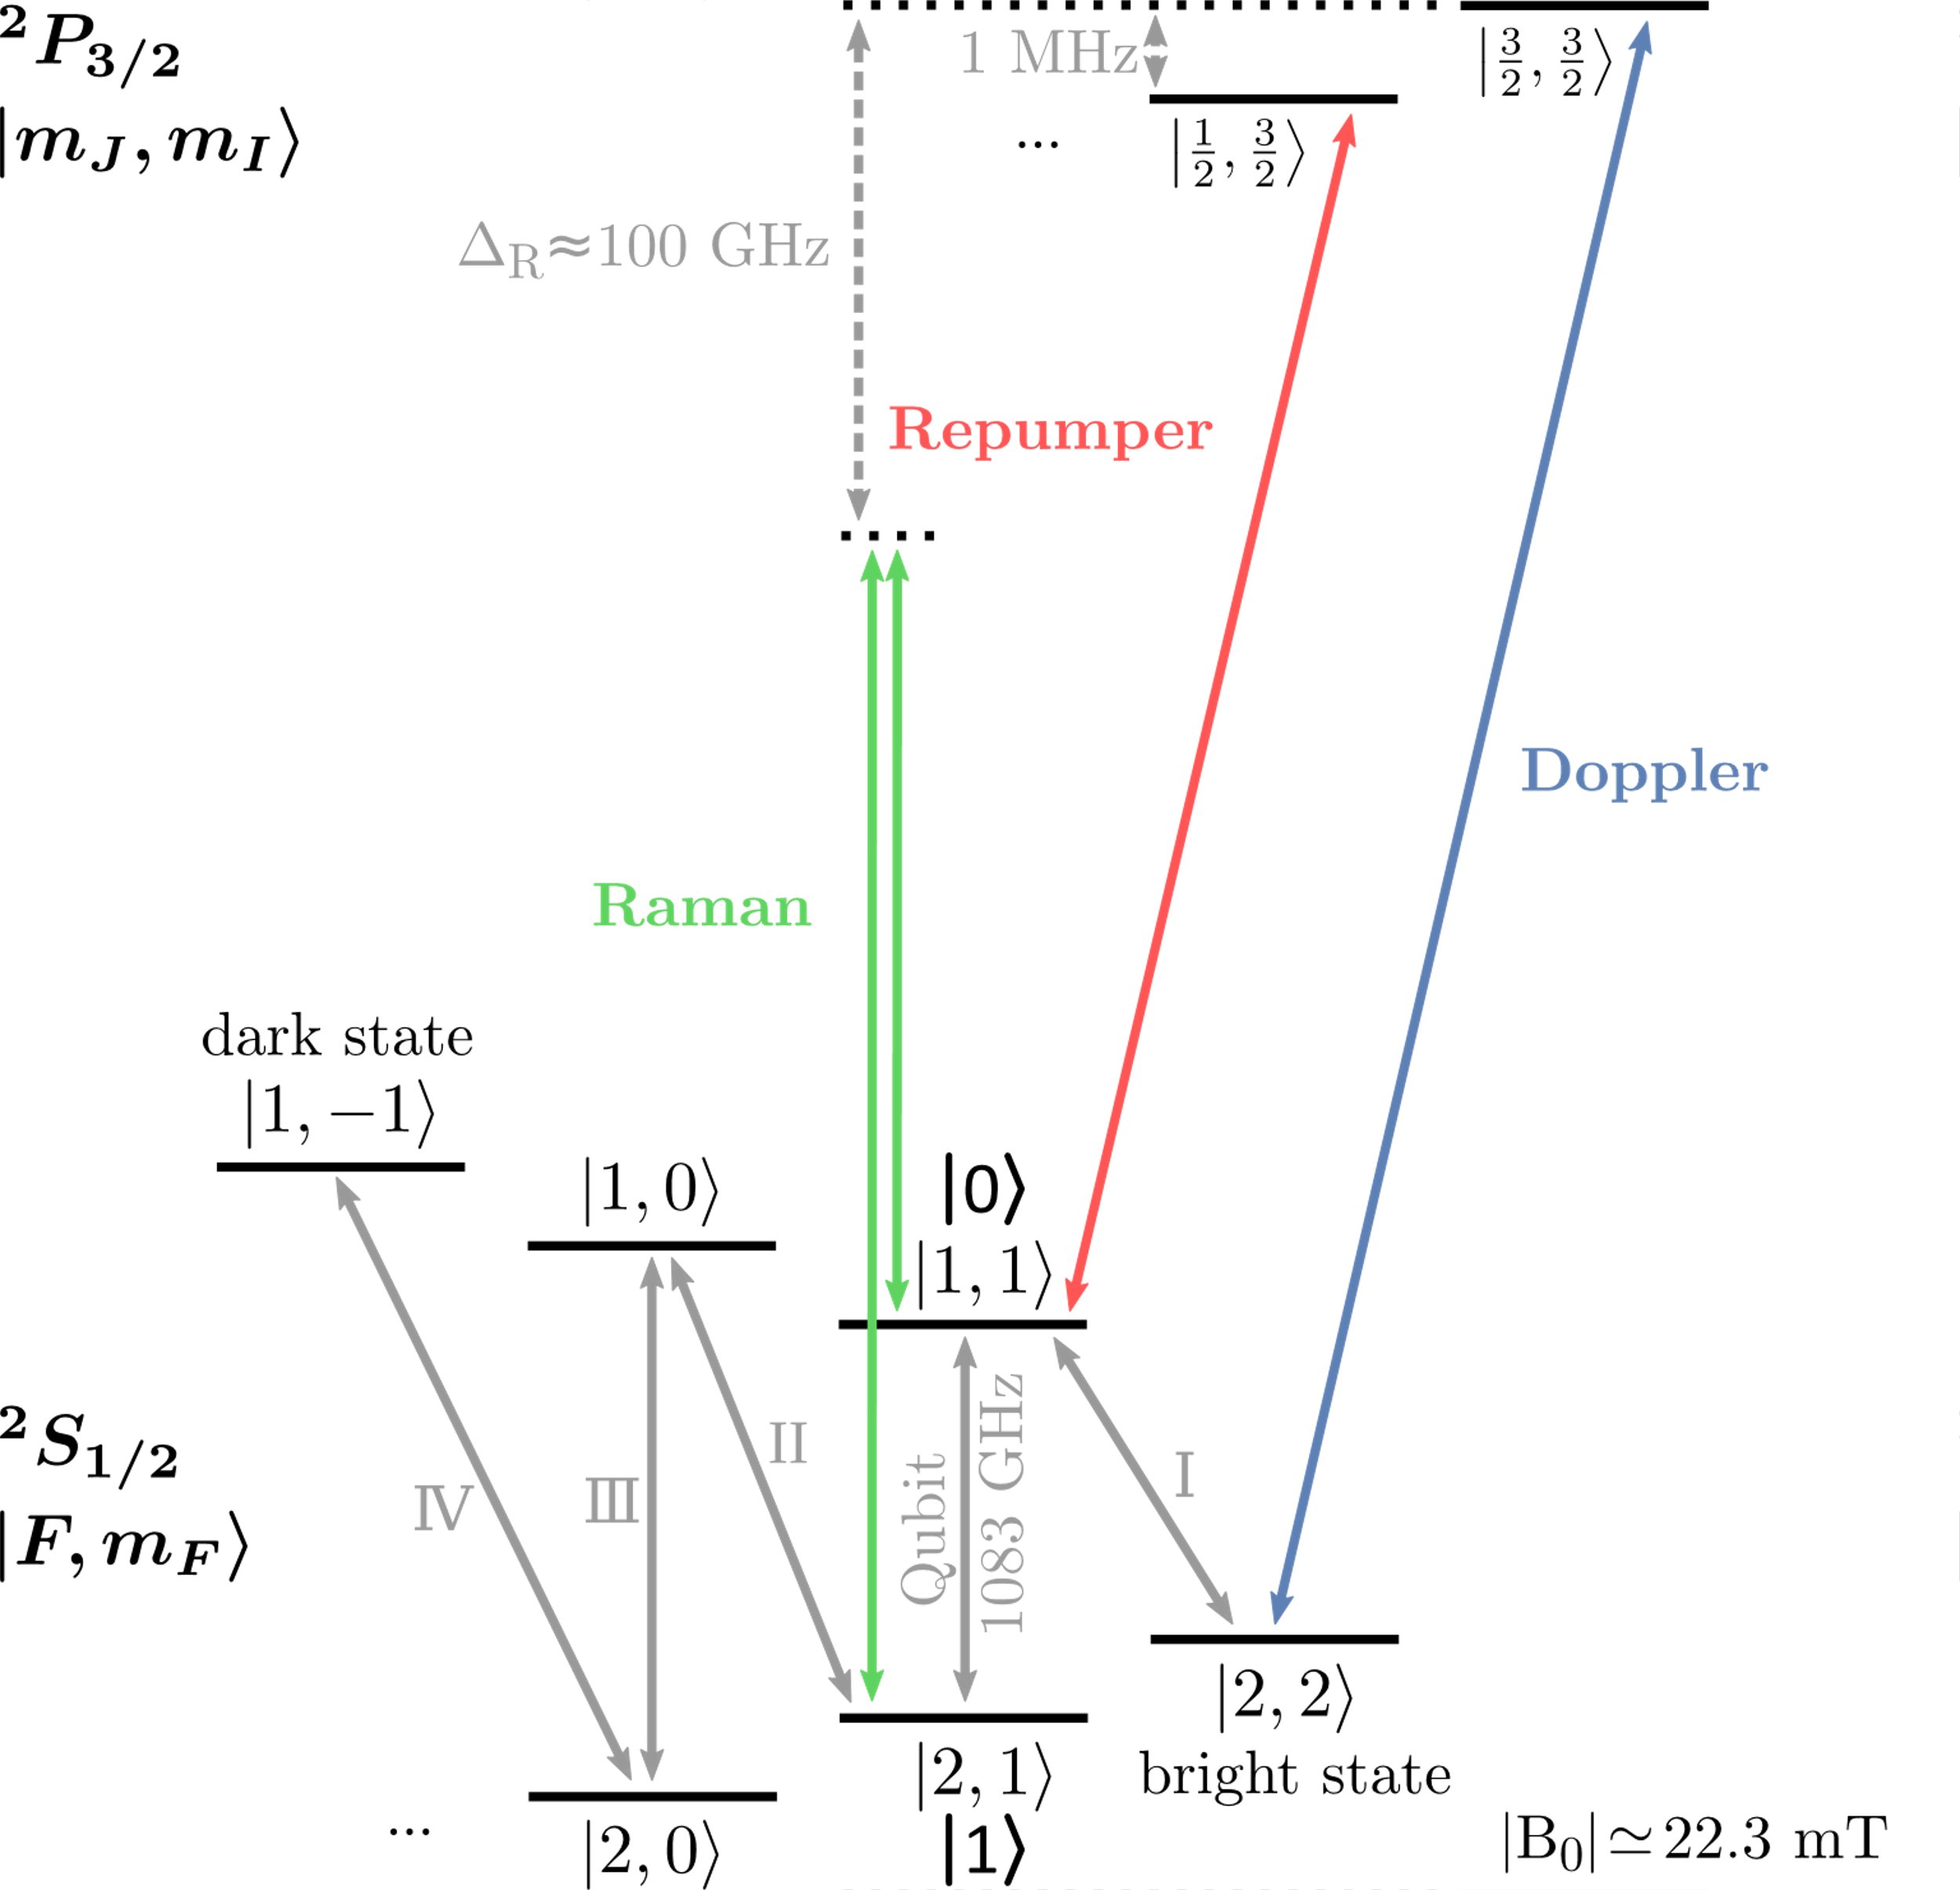
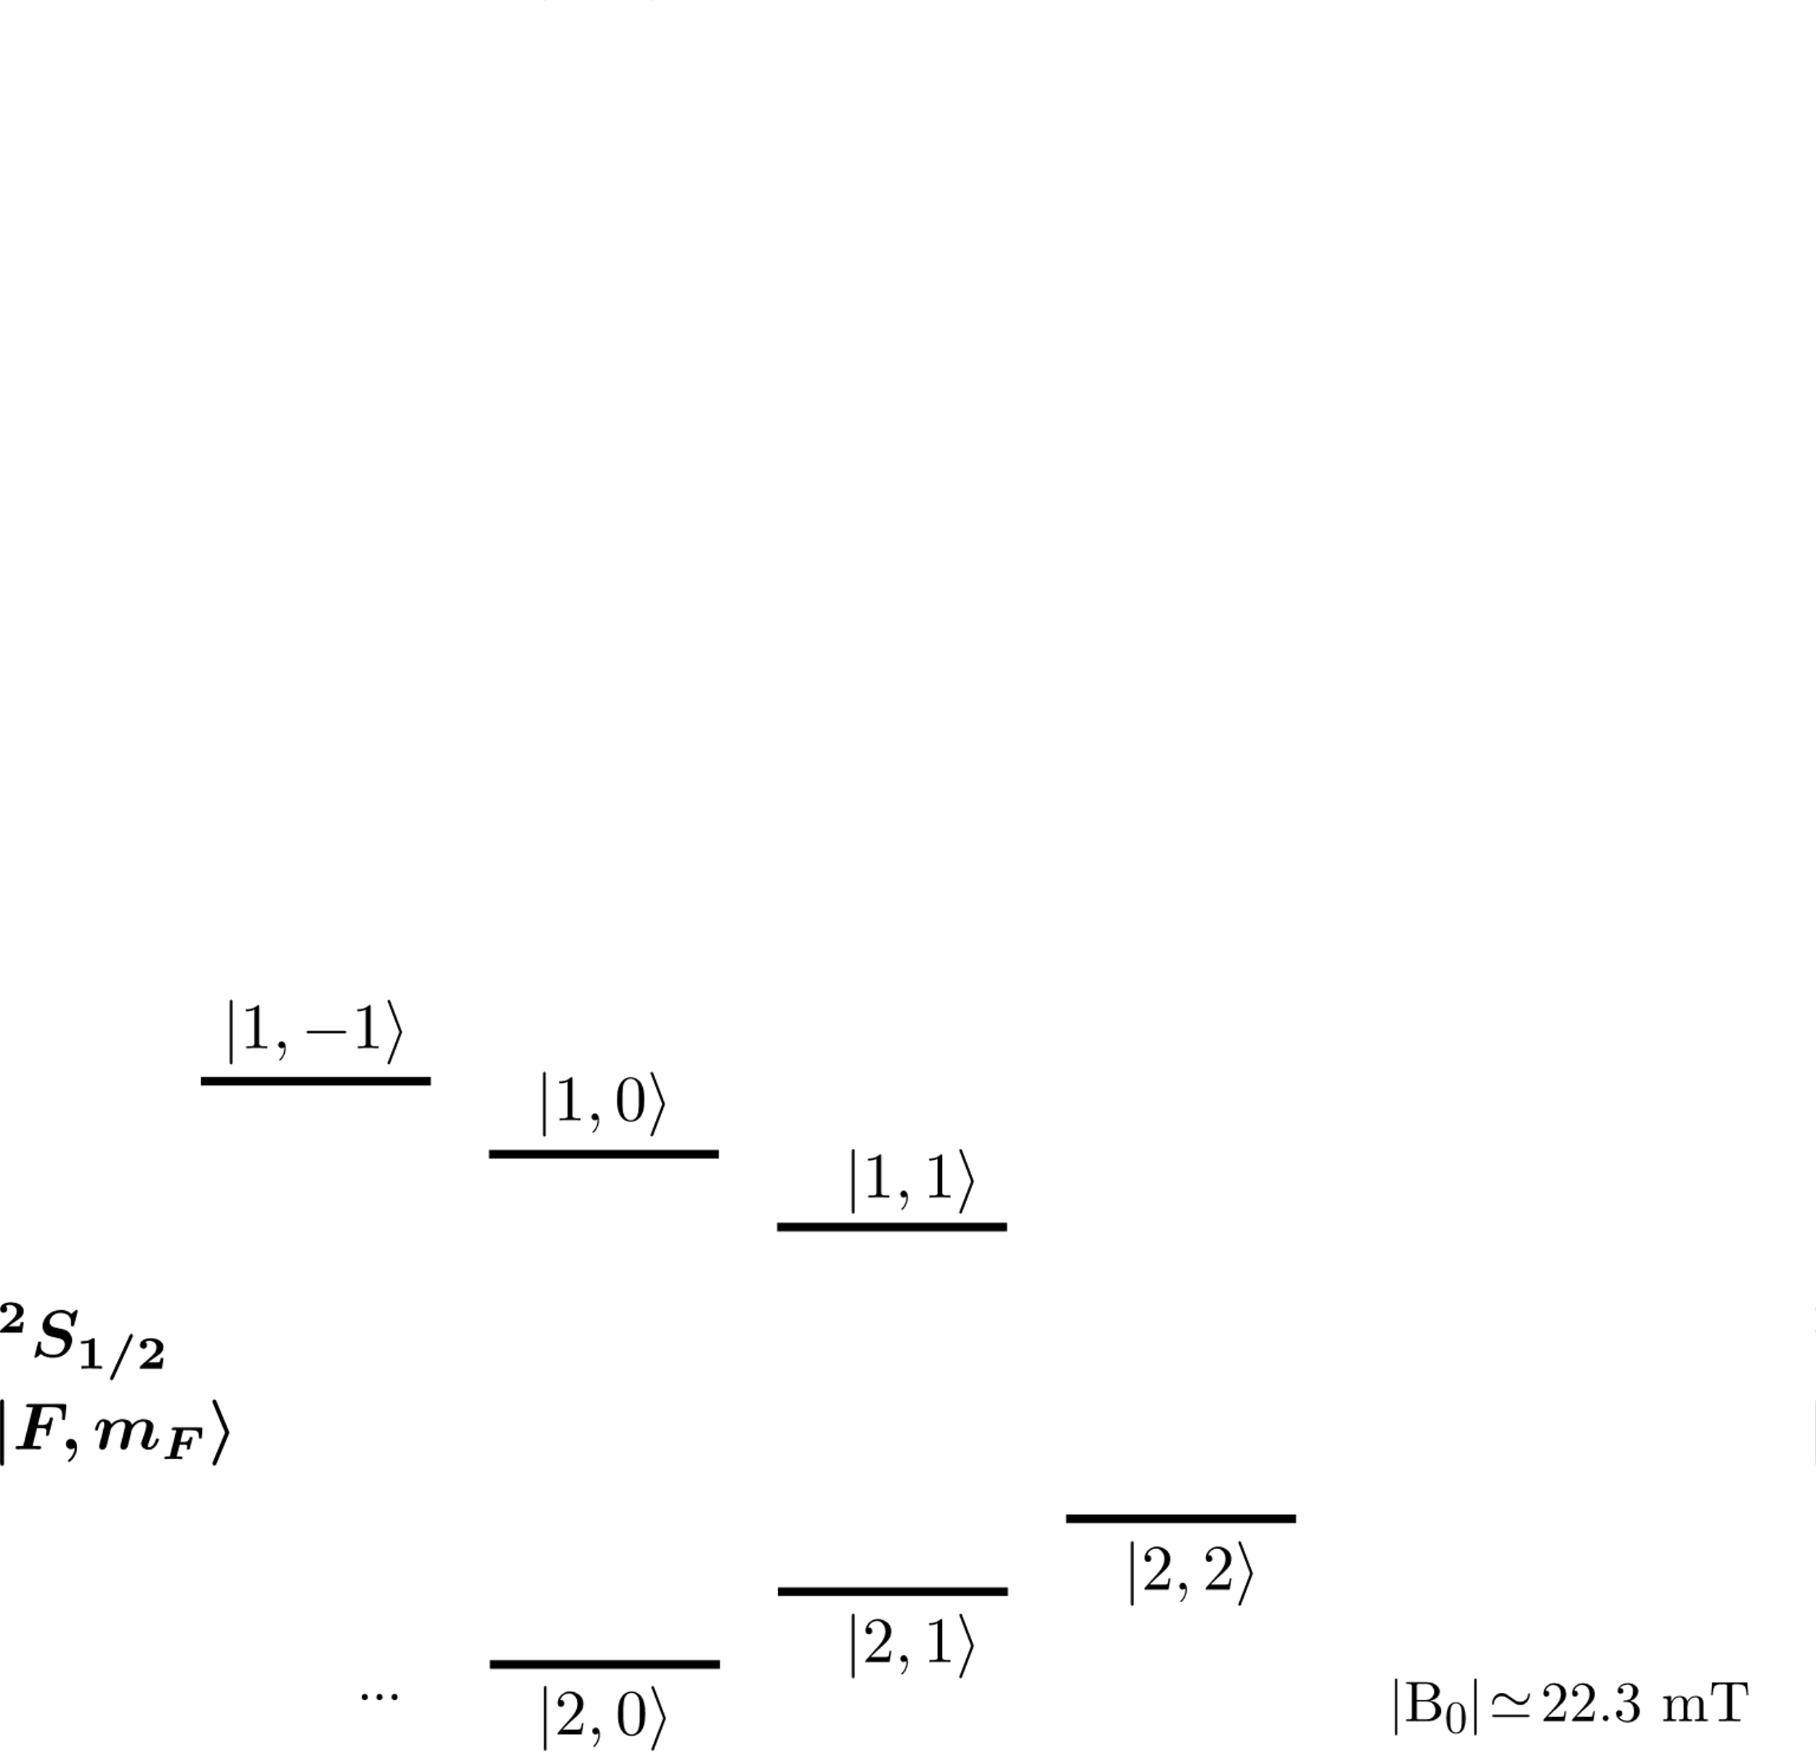
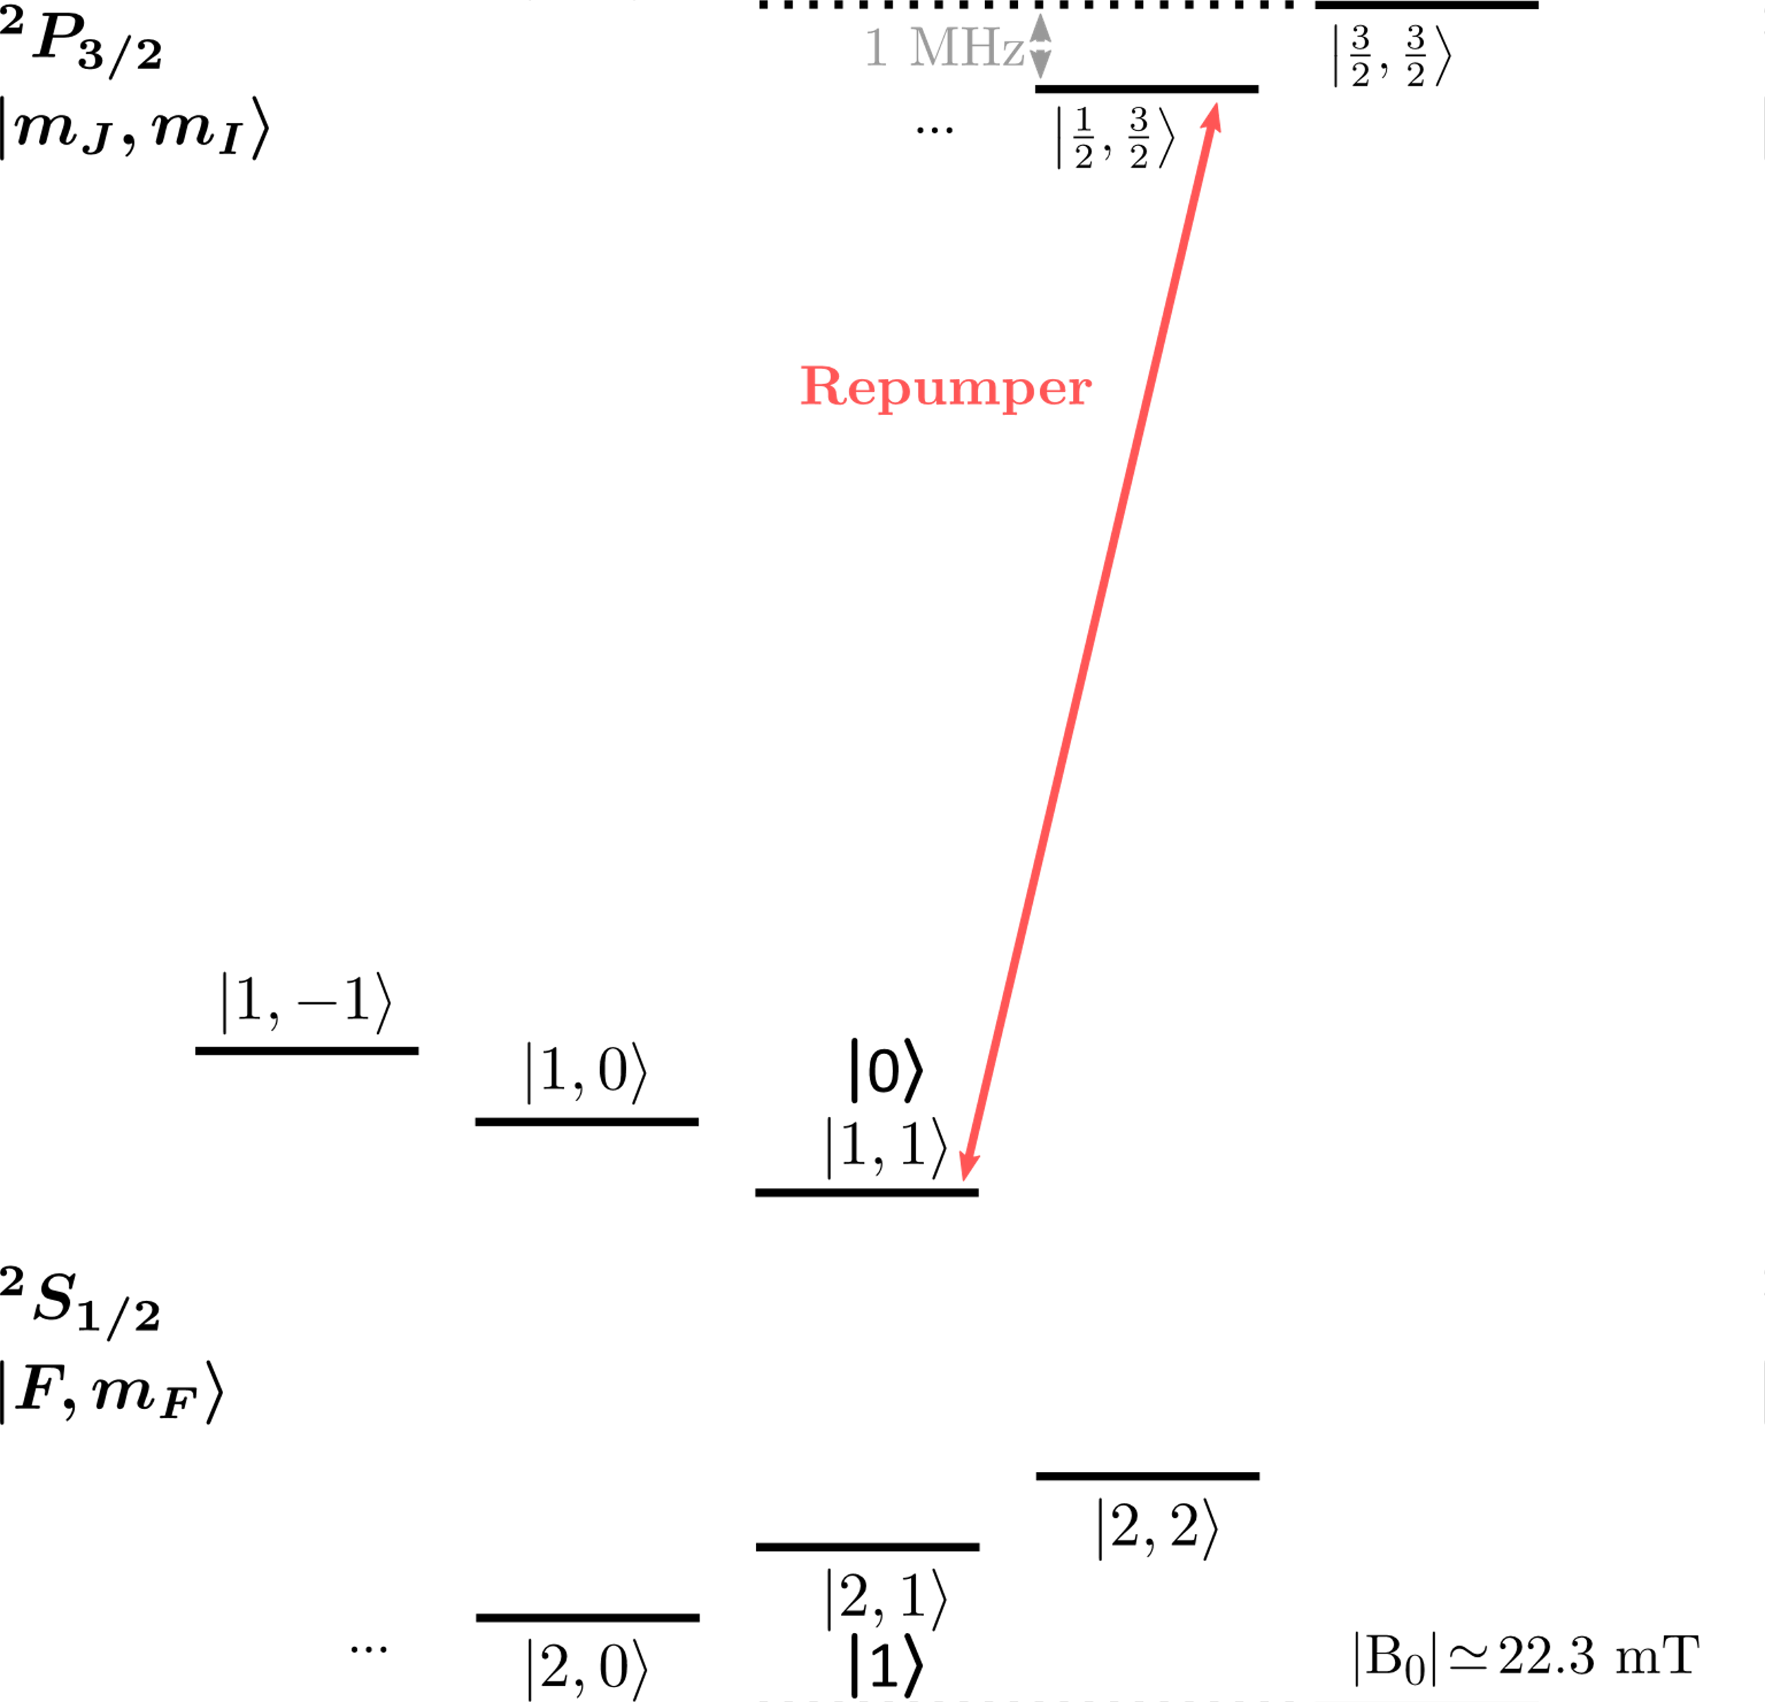
Beryllium: State preparation
Physical sequence:
State initialization in |2,2⟩
Doppler cooling
Microwave hop to |1⟩
Ground-state cooling
Microwave hop to |0⟩
Notes:
No more thatn 30 seconds, just read bullets

Slide 5
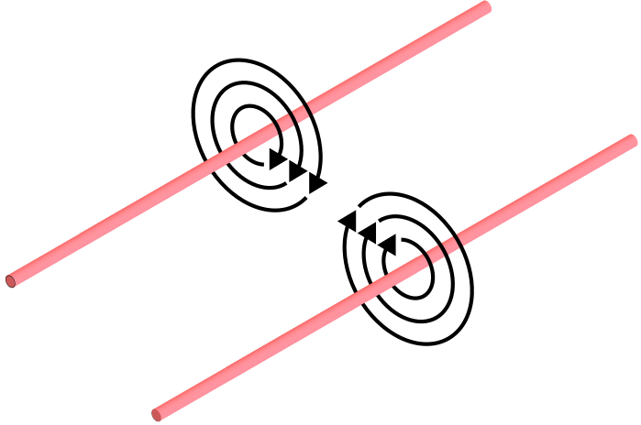
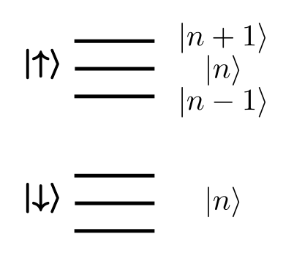
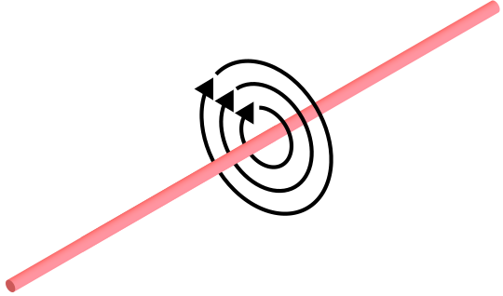

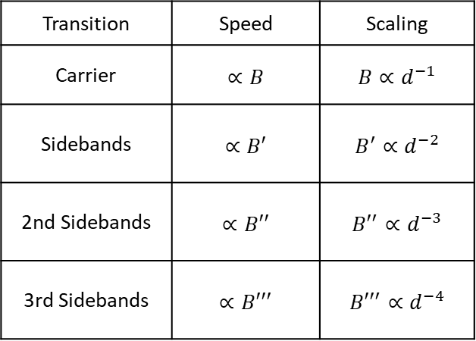

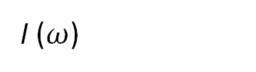
Microwave near-field
I ($ω$)
Transition | Speed | Scaling
Carrier | $$∝B$$ | $$B∝d^{−1}$$
Sidebands | $$∝B′$$ | $$B^{′}∝d^{−2}$$
2nd Sidebands | $$∝B′′$$ | $${B′}^{′}∝d^{−3}$$
3rd Sidebands | $$∝B′′′$$ | $${B′′}^{′}∝d^{−4}$$
+
+
+
d
$$\overset{⃑}{B}$$
$d≪$ $λ$
Microwave
conductor
I ($ω$)
Impact of residual B-field:
  AC Zeeman shift (gate-error)
Notes:
In the MW n.f. approach ion is located close to conductor at a distance d ...
Figure
From theory of interaction between.. Table
In the near-field d<<$λ$ where the B’ amplitude goes as...
Sidebands necessary for multi-qub gates since they couple..
The presence of Bres field can lead to problems such as..
To avoid the issue, is possible to use multiple conduct.. figure

Slide 6
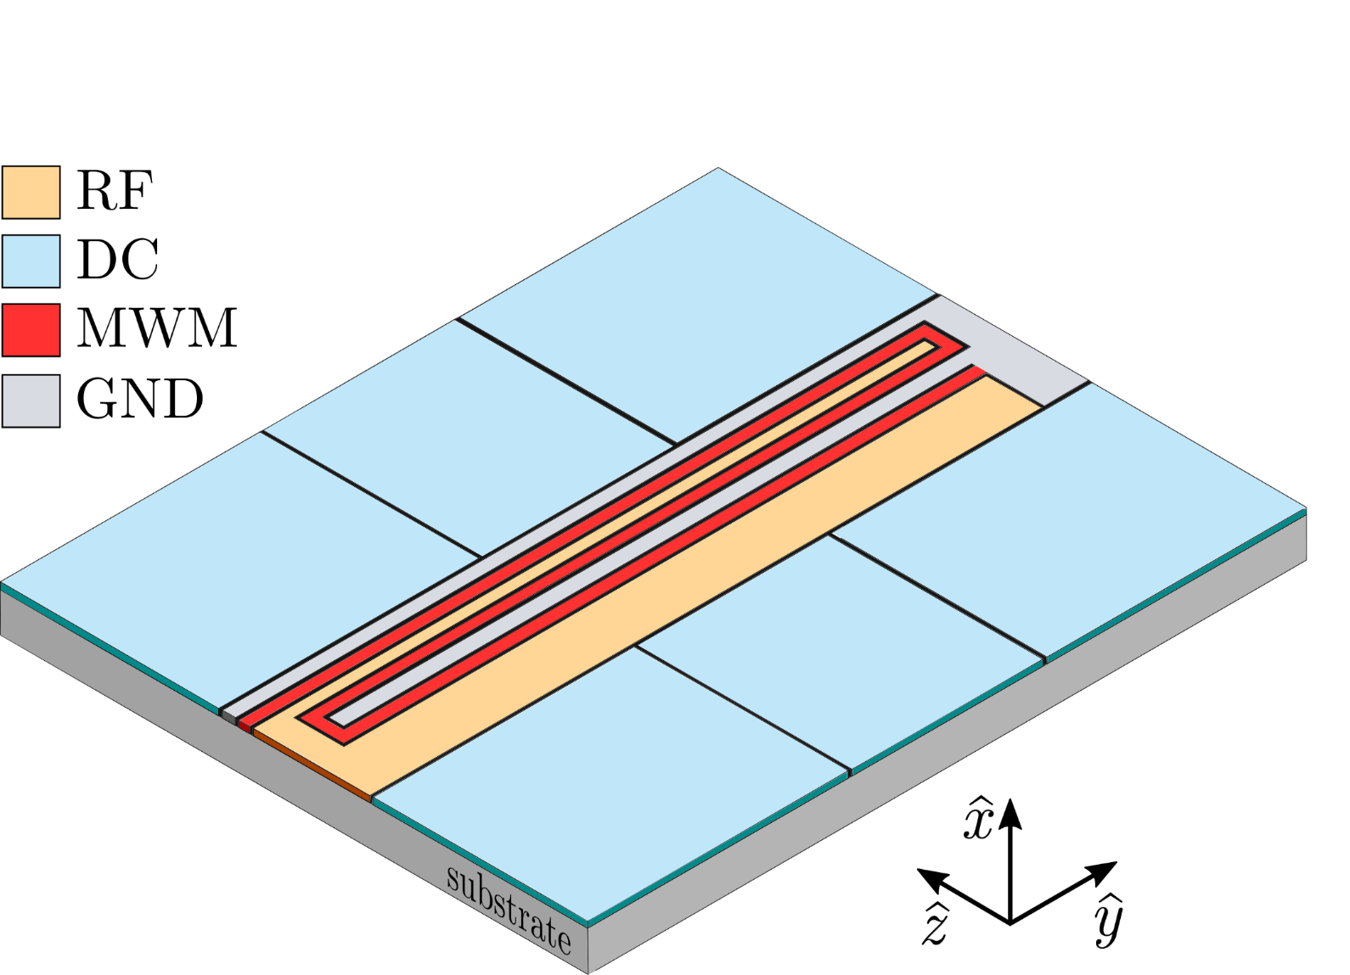

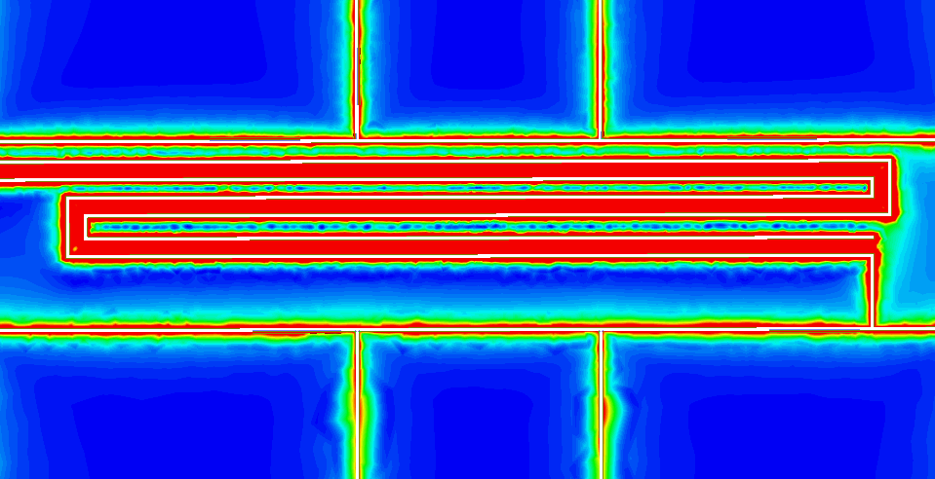
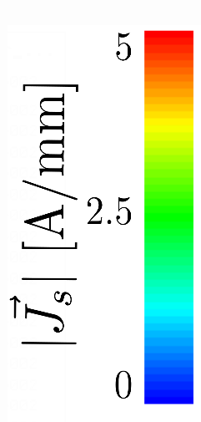
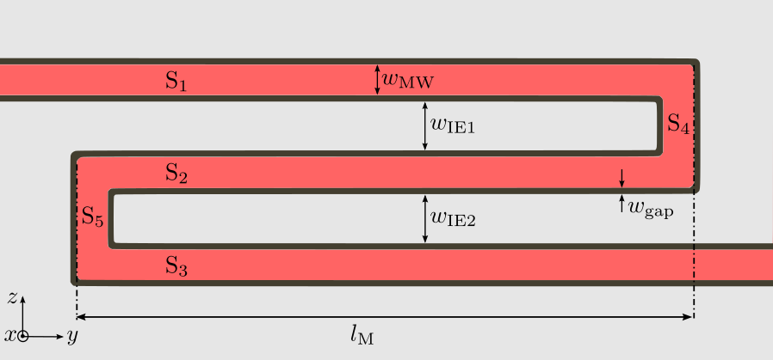
Microwave near-field engineering
d
+
MWM
excitation
Embedded single microwave conductor in surface-electrode ion trap
Single conductor intrinsically phase and amplitude stable
Geometry can be optimized to suppress residual field
M. Carsjens et al., Appl. Phys. B 114, 423-250 (2014)
Notes:
In our system we use single MW cond with 3 segments.
Which ensures relative phase and amp stabil
The conductor generates B field quadrupole with strong B’ and supress B
The cond is integrated in our SE ion trap.
Where the ion is confined with ....
Since we use a single conductor the B field properties are fixed by geomtry
To predict generated field we need to simulate it
We use commercial software to do FEM sim which accounts for many effects such as..
From result we can extract useufl info, currents and B

Slide 7
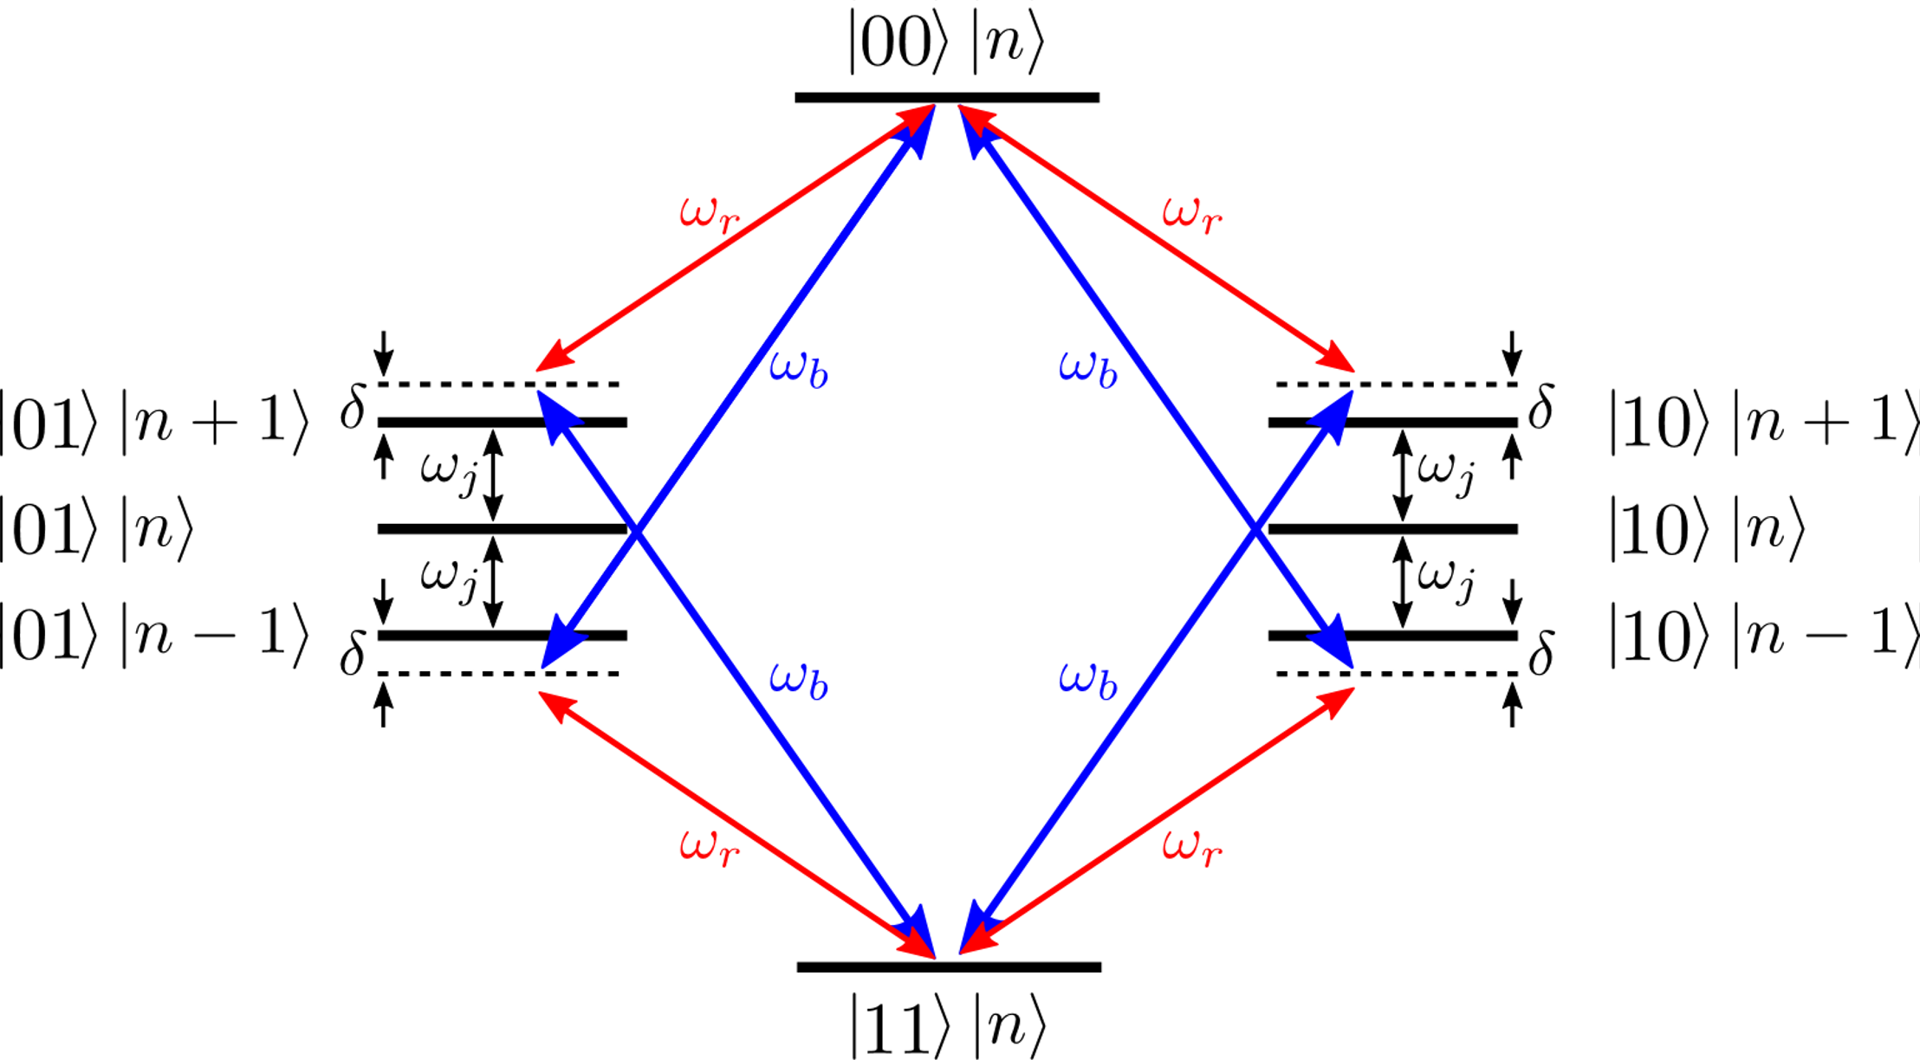
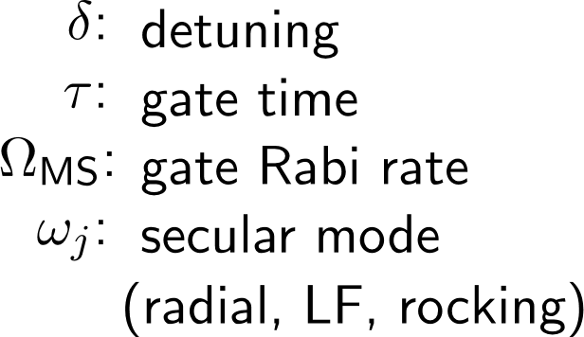
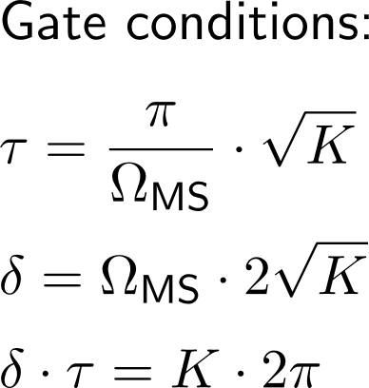
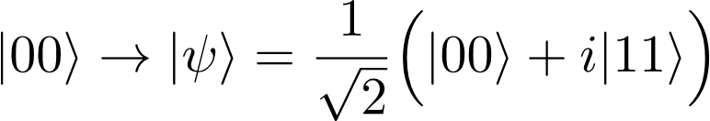
Mølmer-Sørensen gate
Klaus Mølmer and Anders Sørensen Phys. Rev. Lett. 82 (1999)

Slide 8
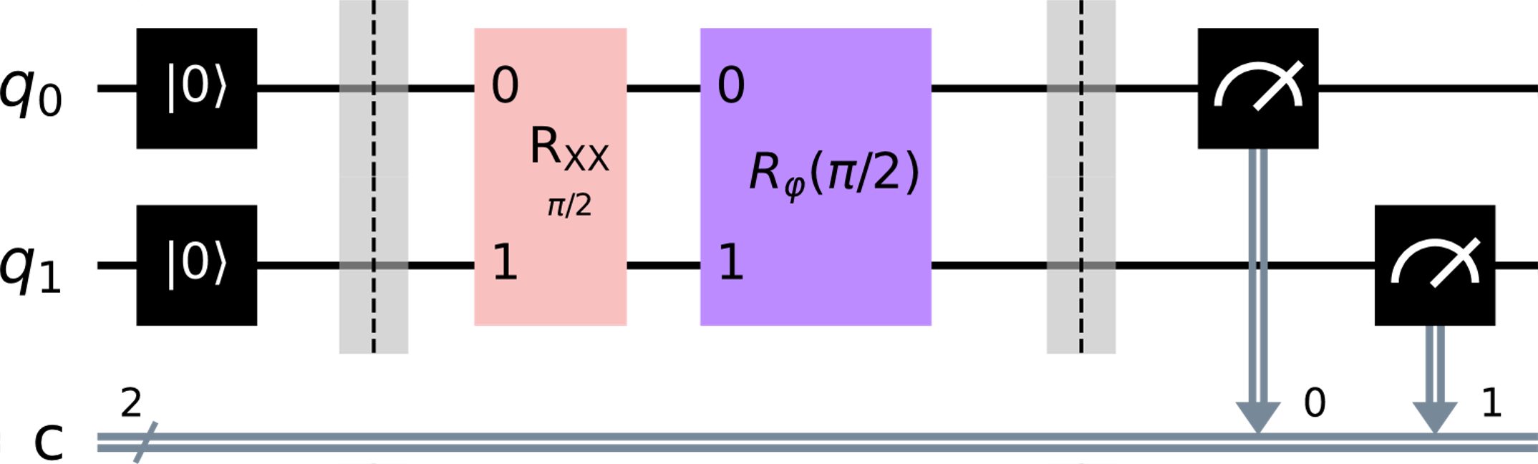
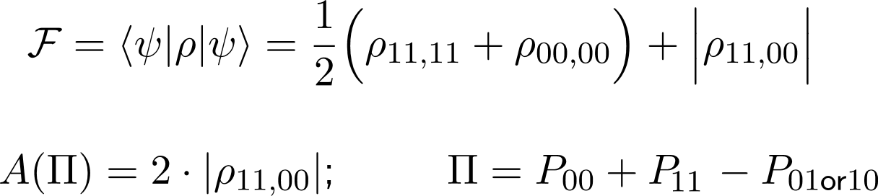
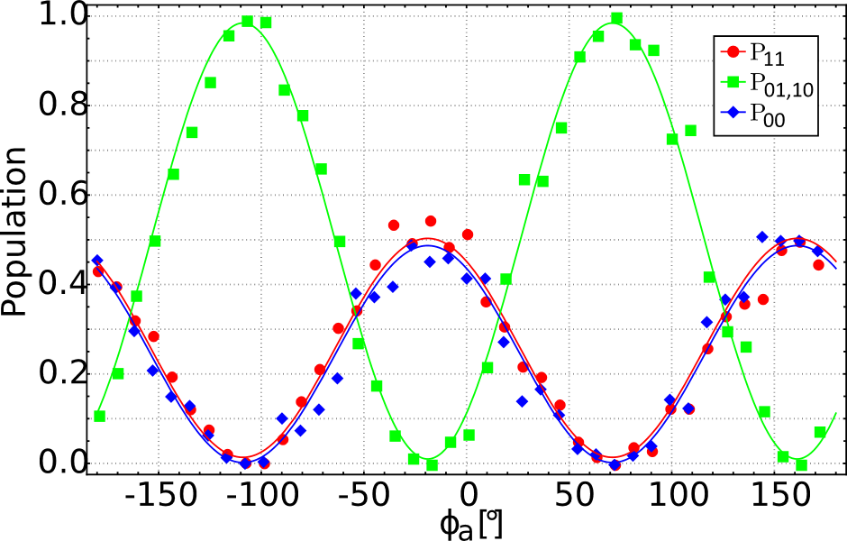
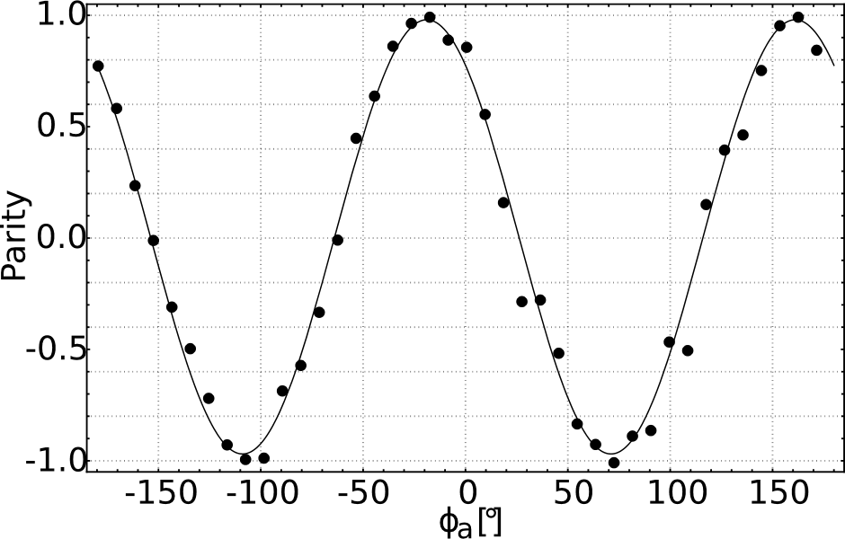

Mølmer-Sørensen gate: Fidelity analysis
Sackett et al., Nature 404, (2000)
scan φ
Hahn et al., npj Quantum Inf 5, 70 (2019)
Effect | Infidelity
Mode instability | 1.3 × 10⁻²
Spectator mode | 5.2 × 10⁻³
Motional heating | 3.8 × 10⁻³

Slide 9
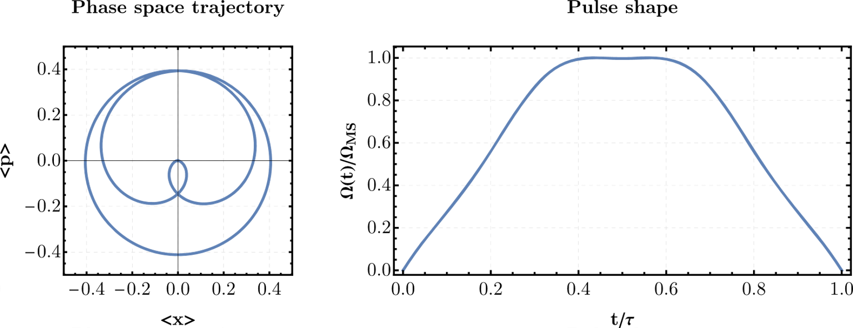
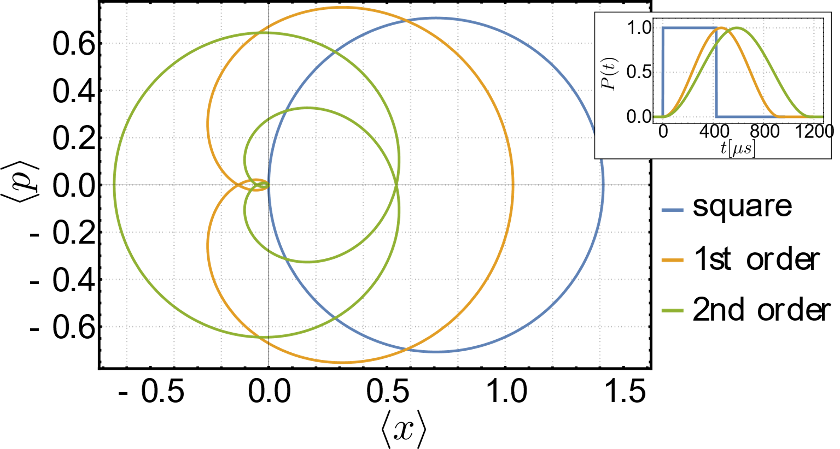
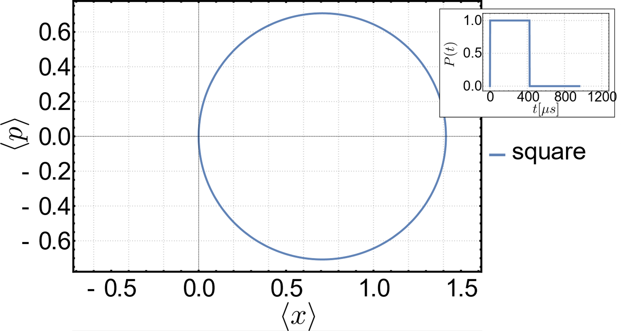
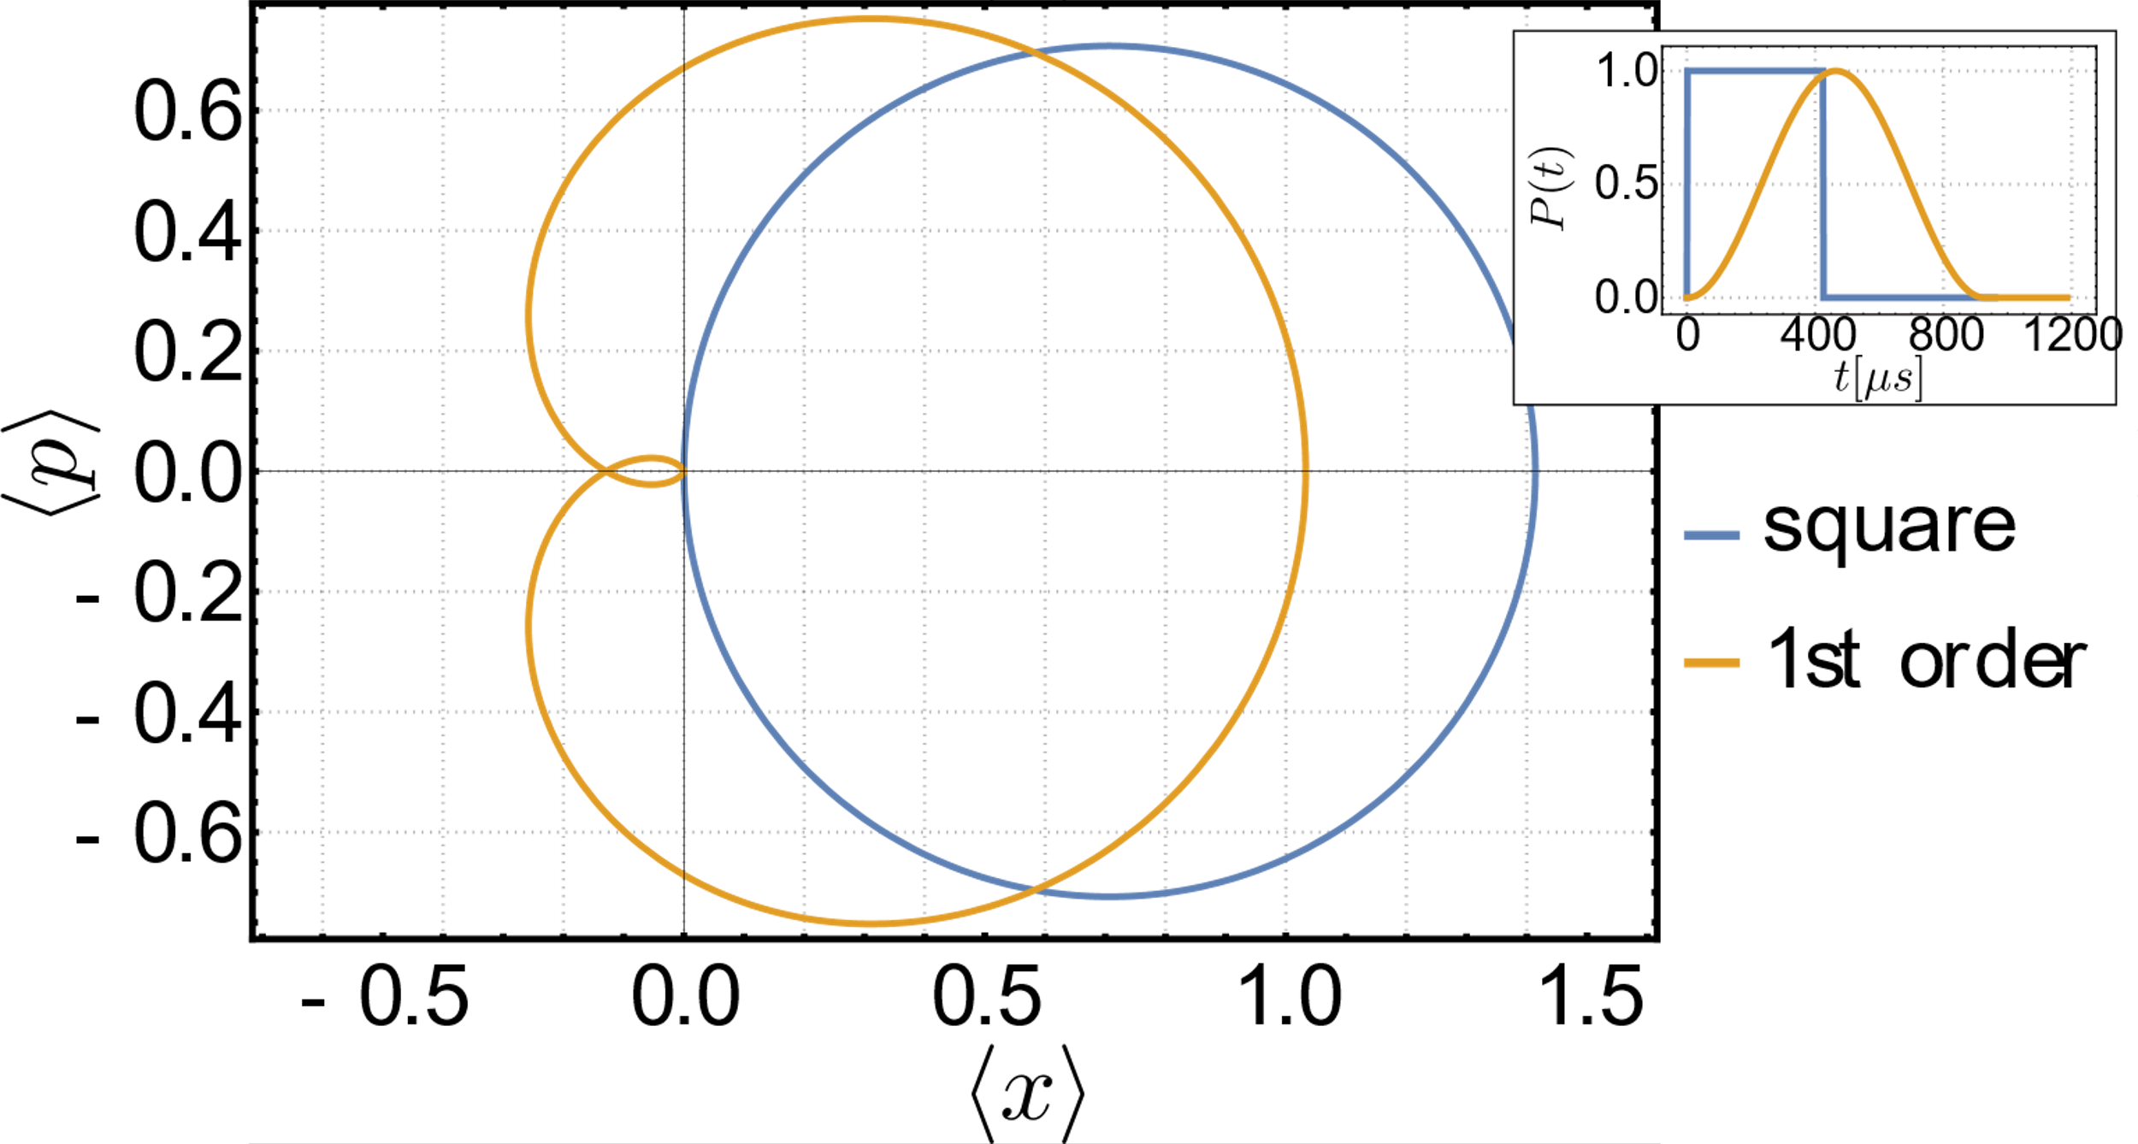
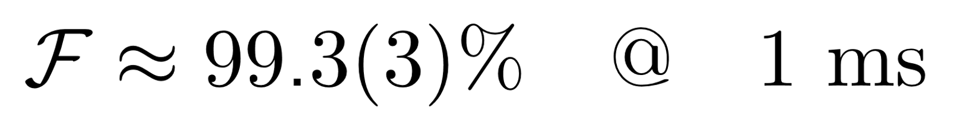
Mølmer-Sørensen gate: Pulse shaping
M Duwe et al 2022 Quantum Sci. Technol. 7 045005
Zarantonello et al., PRL, 123, (2019)

Slide 10
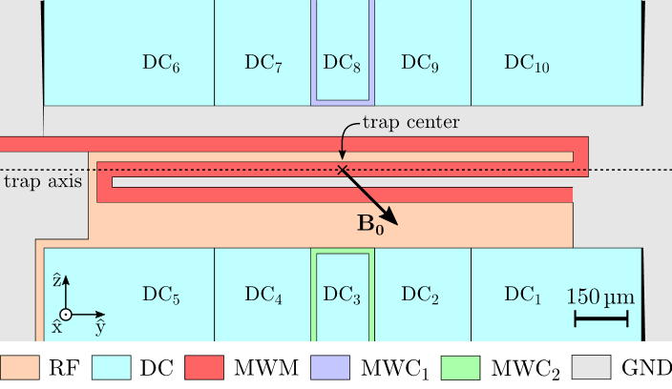

Single-ion addressing
Rotate ion crystal
Displace ion to be addressed out of micromotion minimum
Micromotion sideband interaction
Qubit 1
Qubit 2
+
x
+
Trap center
U. Warring et al., PRL 110, 173002 (2013)
D. Leibfried –PRA 60, R3335(R), (1999)

Slide 11
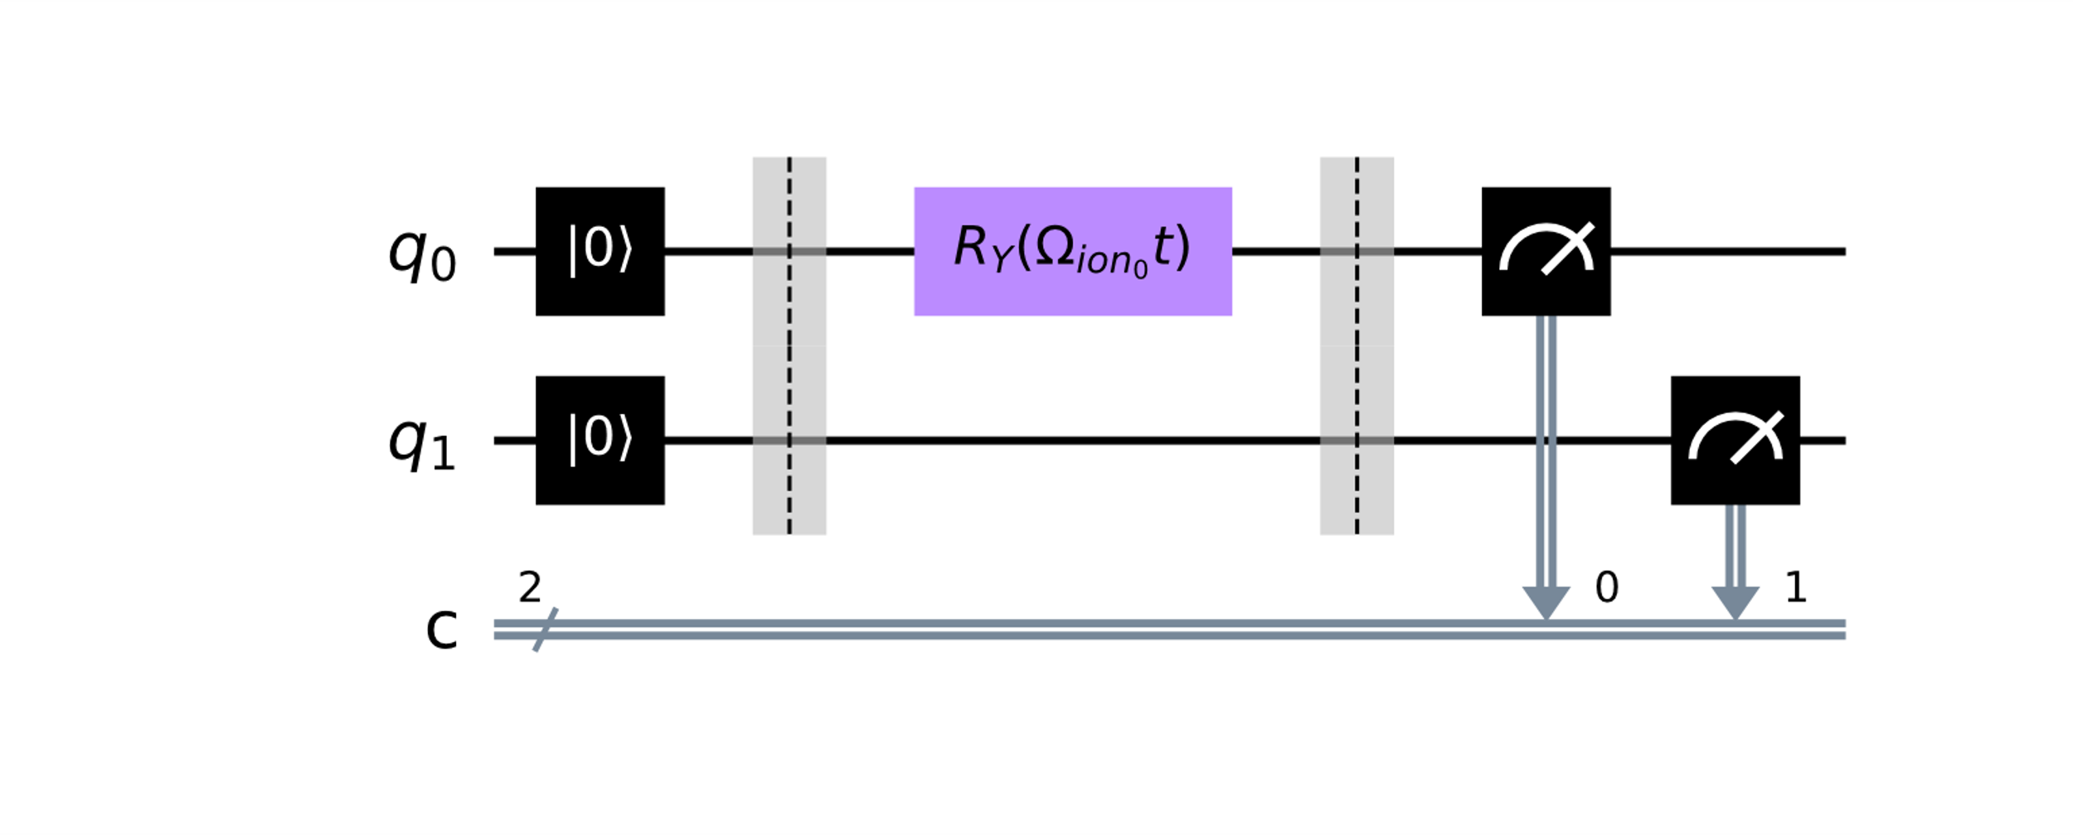
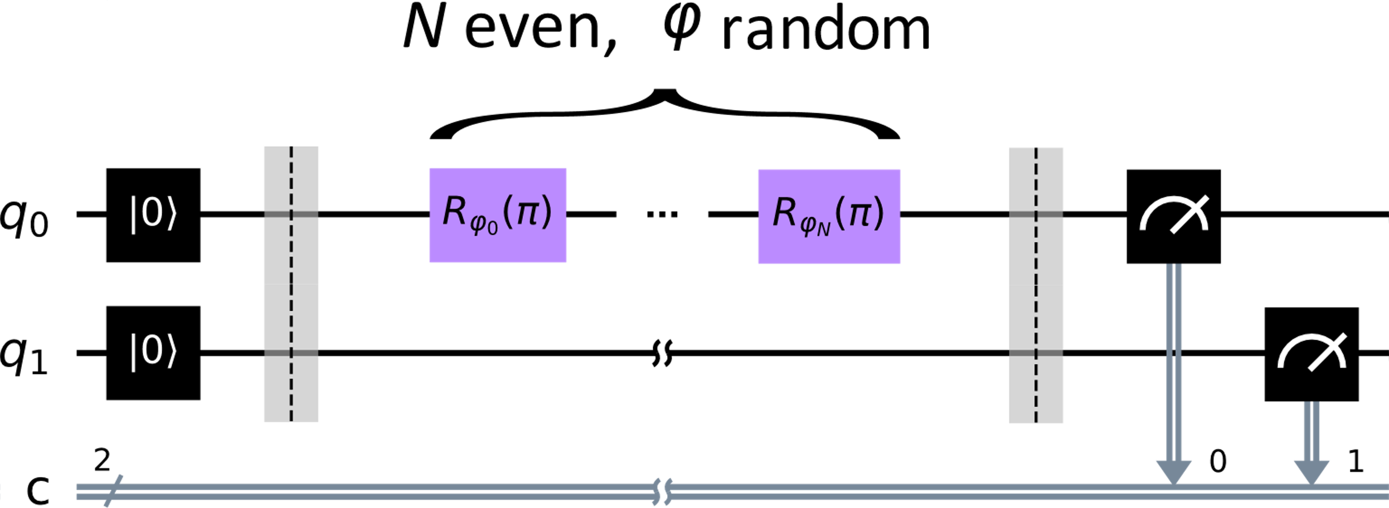
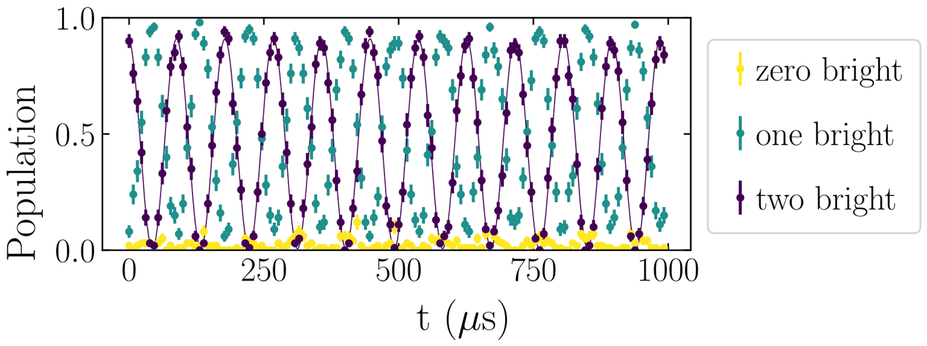
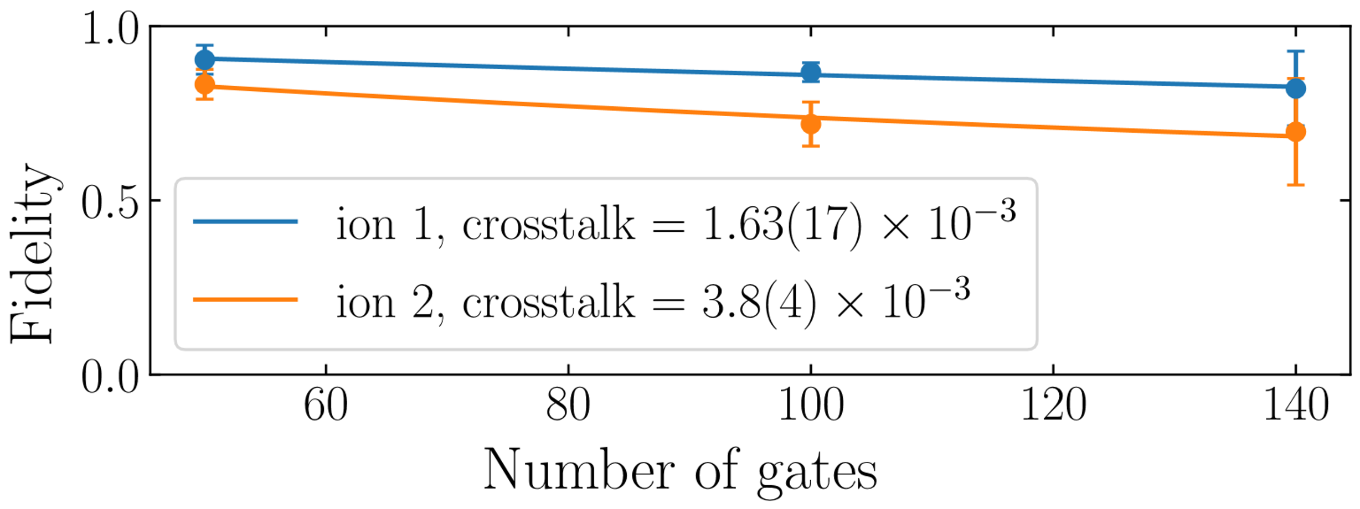
Single-ion addressing: Flopping and crosstalk
scan t
Piltz et al., Nat Commun 5, 4679 (2014)
Ω_{ion0} = 2π × 11.145(5) kHz
Ω_{ion1} = 2π × 5.655(5) kHz

Slide 12
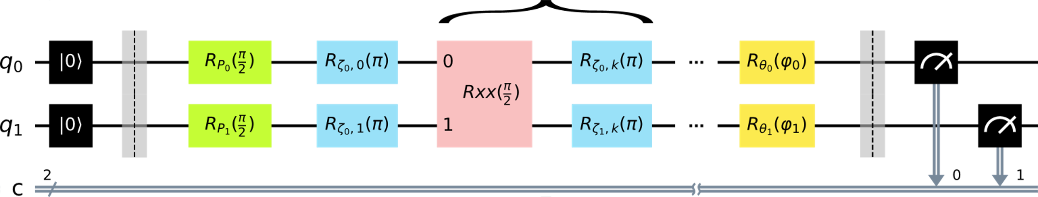
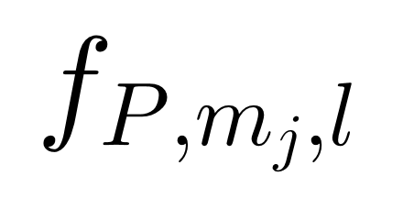
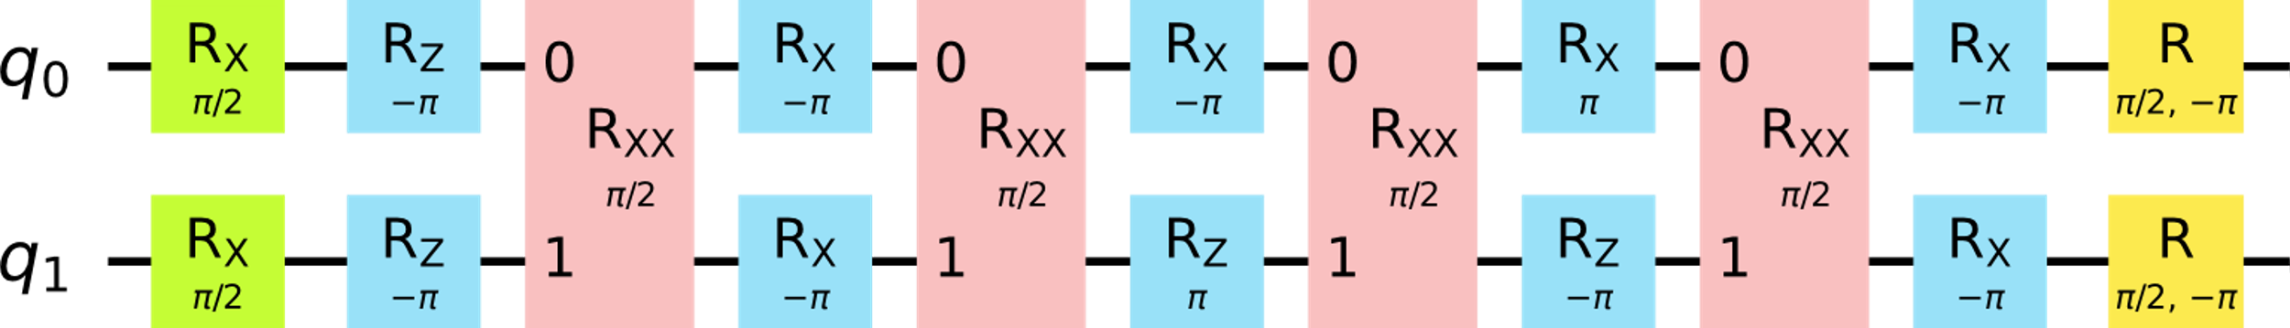
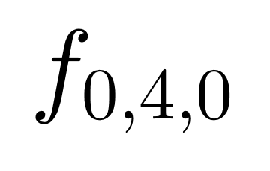
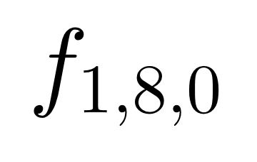
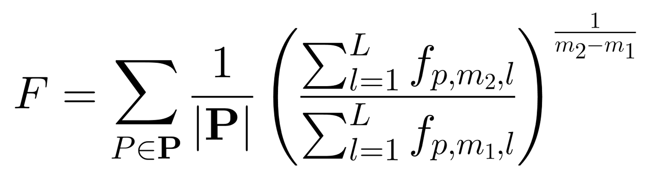
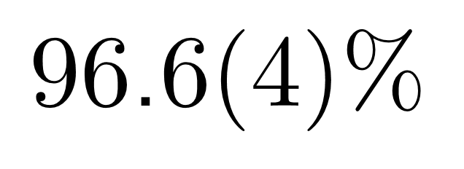
Simple circuits: Cycle benchmarking
repeat m_{j} times
Erhard et al., Nat Commun 10, 5347 (2019)

Slide 13
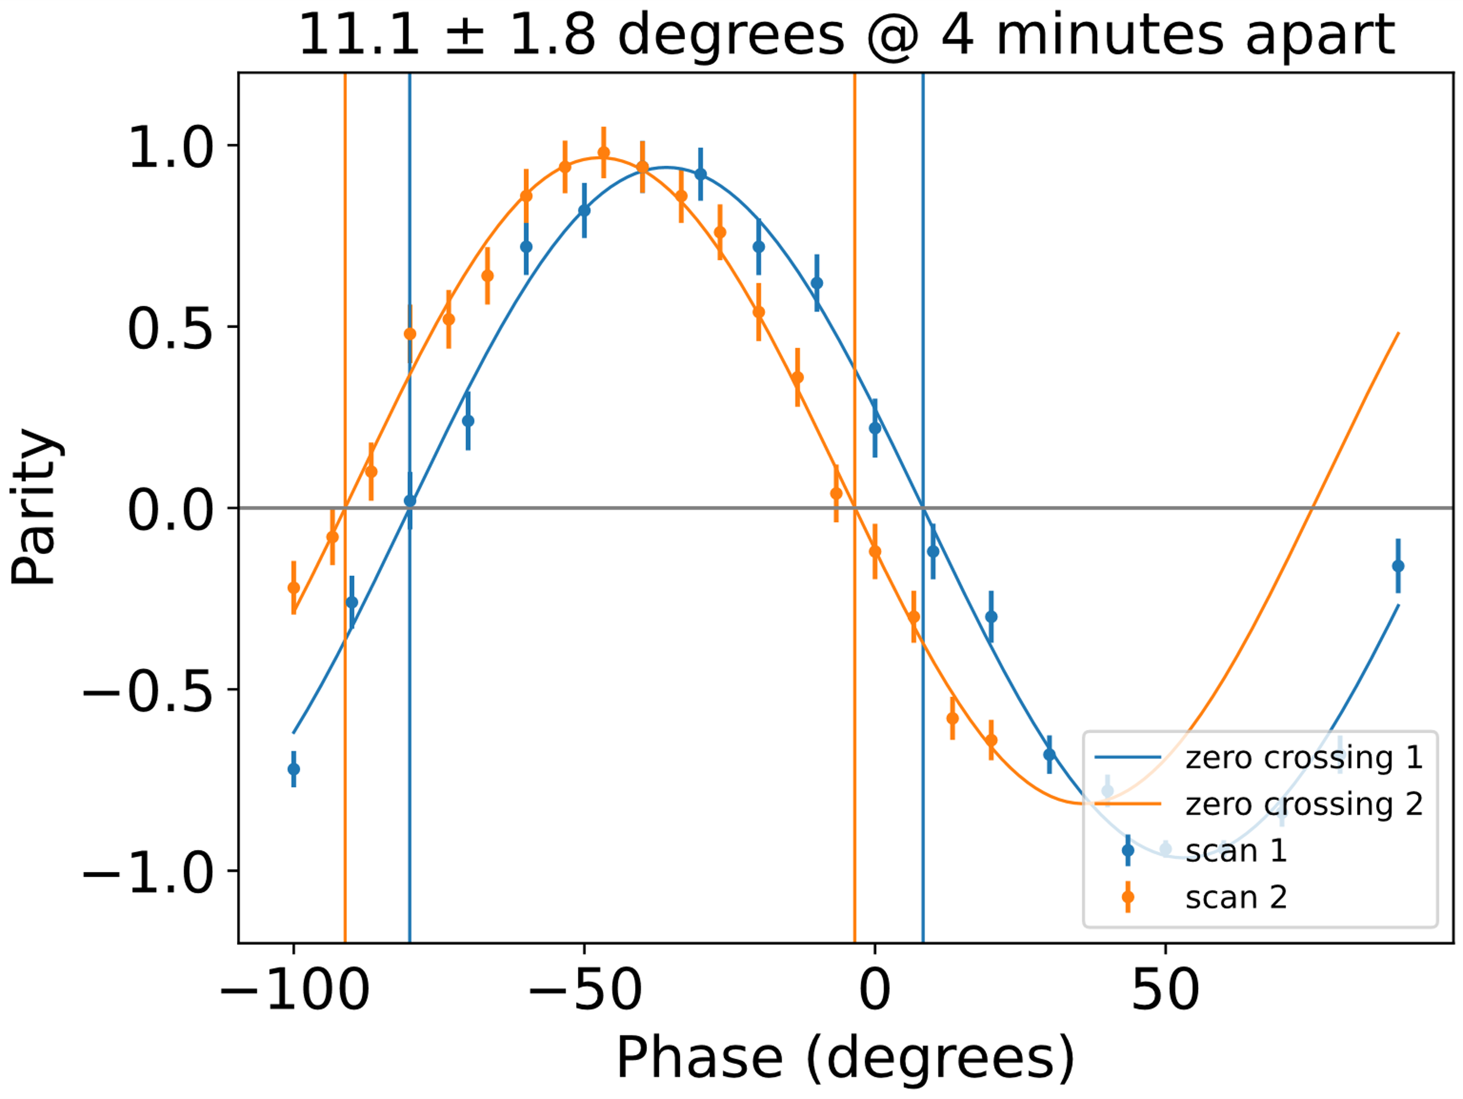
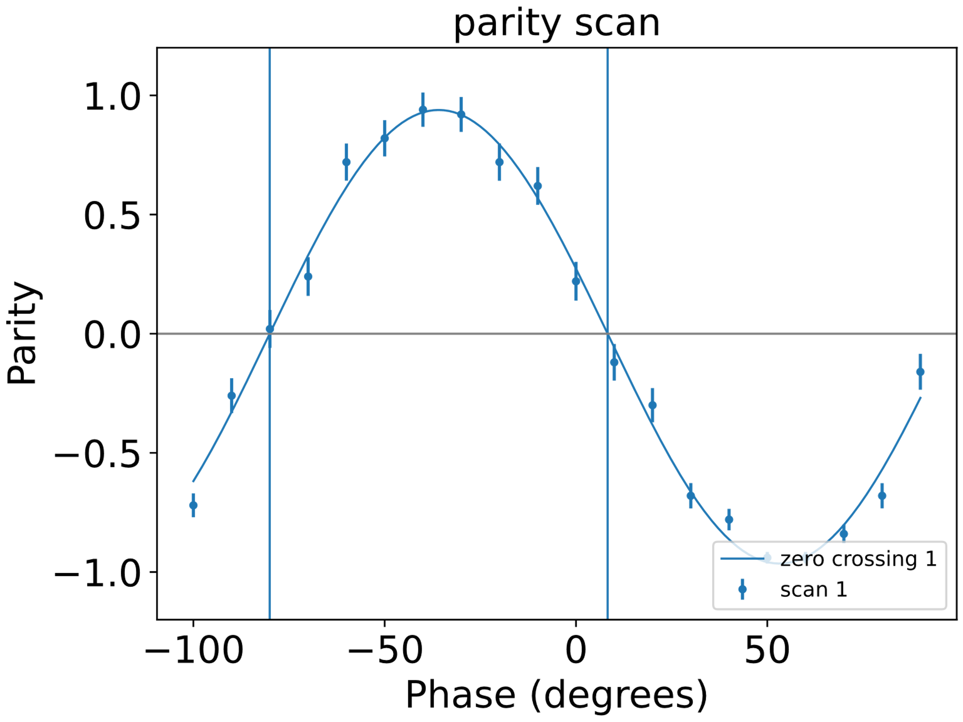
Discussion
Why 96.6 % fidelity?
Calibration errors
  Mode​ / detuning
    We are robust
  AC Zeeman shift
    Need order of magnitude more
  Phase (principal suspect)
    Offset between 1 and 2-qubit gates
    Frame of reference
    10º per circuit?

Slide 14

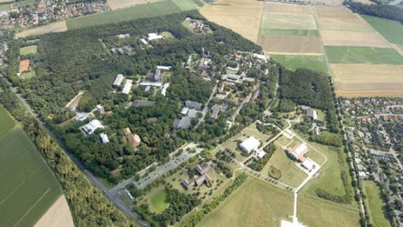









Acknowledgments
Thanks to my colleagues:
  Hardik Mendpara, Markus Duwe, Christian Joohs a.k.a. CJ, Alexander Onkes, Yannick Hermann, Giorgio Zarantonello, Amado Bautista-Salvador, Ludwig Krinner, Christian Ospelkaus, …
Thanks to the Alumni:
  M. Wahnschaffe, H. Hahn, …
We greatly acknowledge all of our third-party funding

